Slide 1
Calculating Solar Na Abundance
Group 1: Matt Lastovka, Cassie Moats, Sam Eckart, Kolya Larson, William Wu

Slide 2
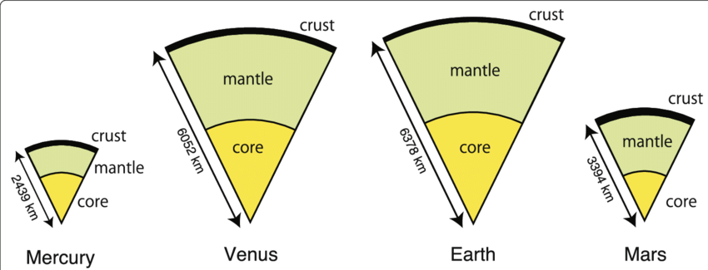
Background
Want planet abundances & internal structure
Stellar abundances seem to match
Curve of growth method used to calculate stellar abundances
We will calculate solar sodium (Na) abundance
Notes:
To understand internal planet structure, we need planet abundances
From Fe, Si, Mg, we can get CMF
Can compare to CMF derived from planet mass and radius
Similarities and discrepancies reveal structure (Large atmosphere/water world, Mercury/super-Mercury, etc.)
Stellar abundances seem to match planetary abundances (for Earth)
Relative abundances of heavy elements (iron, sodium, silicon, magnesium, etc.)
We can get stellar compositions from spectra
Absorption depth implies abundance

Slide 3
Methods
Find equivalent width, then number density of Na using curve of growth
Find ratio of Na in ground & excited states using the Boltzmann Equation
Find ratio of neutral to ionized Na using the Saha Equation
Compute total column density of Na in the Sun
Use column density to find solar Na abundance

Slide 4
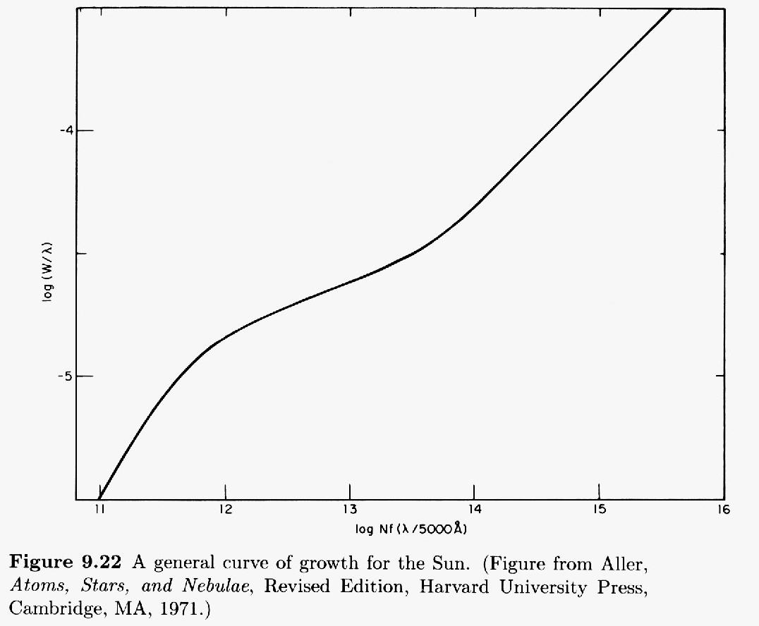
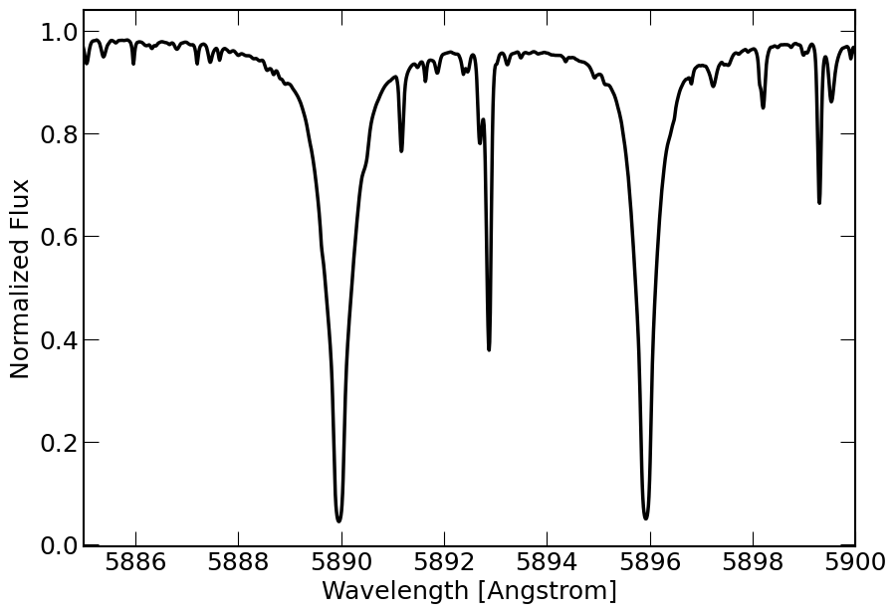
Methods
eW = 0.835 Å
log(W/λ) = -3.85
Log Nf(λ/5000Å) = 14.8
N = 8.24 ⨉ 10^14 atoms/cm²

Slide 5
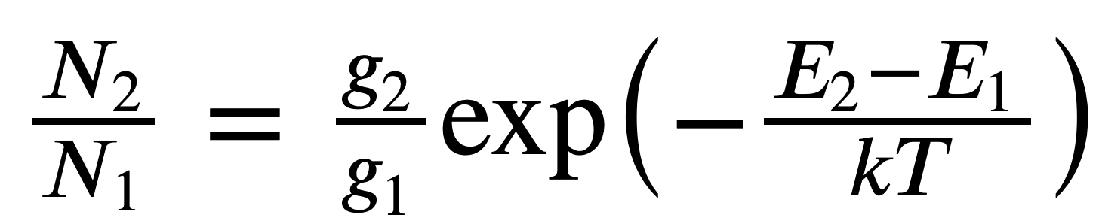
Methods
Calculate ratio of excited states to ground state using the Boltzmann Equation
g₁ = 2, g₂ = 6
E2 - E1 = 2.11 eV
T = 5780 K (solar effective temperature)
N₂ / N₁ = 0.0048

Slide 6
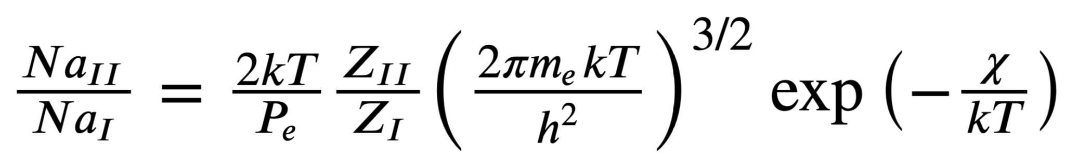
Methods
Calculate ratio of ionized to neutral sodium using the Saha Equation
Z_{II} = 1, Z_{I} = 2.4 (Partition function)
P_{e}= 1.0 N m⁻² (electron pressure)
χ = 5.1 eV (ionization energy)
Na_{II} / Na_{I} = 2518.0

Slide 7
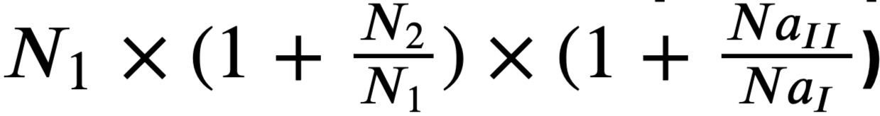
Methods
Calculate total column density of Na atoms in the Sun
N_{Na} = 2.09 x 10¹⁸ atoms/cm²

Slide 8
Results
N_{H} = 6.6 x 10²³ atoms/cm²
Physicist | Astronomers (galaxies) | Astronomers (stars)
Mole ratio between Na and H | Log of mole ratio between Na and H (offset by 12) | log((Na/H)/(Na/H)_{literature})
N_{Na} / N_{H} | 12 + log(Na/H) | [Na/H]
3.16 x 10⁻⁶ | 6.50 | 0.2

Slide 9
Discussion
Calculated abundance of 6.50 similar to known solar Na/H (6.3)
Did not calculate uncertainties here
Method could be applied to other elements: Fe, Si, Mg
These are more useful for determining planet composition

